Slide 1



赛普机电Saipu Electromechanical
国际标准·精工品质
International standard ·Exquisite workmanship and quality
Notes:
https://www.58pic.com/newpic/28894764.html

Slide 2

①
公司简介
Company profile
②
公司荣誉
Company honor
主要合作客户
Major Cooperative Clients
③
目 录
CONTENTS
组织机构
Organization
④
⑤
开发能力展示
Development capability display
⑥
品保能力展示
Display of Quality Assurance Ability
⑦
生产组织能力展示
Display of the production organizational capacity
⑧
产品展示
Product display
⑨
业绩展示-产销量
Performance Display - Production and Sales Volume

Slide 3
PART 1
公司简介
Company Profile

Slide 4
简 介
Brief introduction
重庆赛普机电有限责任公司成立于2010年8月，公司位于重庆市沙坪坝区中梁镇石院村工业园，占地面积8000余平方米，主要从事通用汽油机化油器的研发、生产、销售和服务于一体的制造企业。
Chongqing Saipu Electrical and Mechanical Co., Ltd. was established in August of 2010. The company which is located in Shiyuan Village Industrial Park, Zhongliang Town, Shapingba District of Chongqing, covering an area of more than 8000 square meters, is a manufacturing enterprise mainly engaged in the research and development, production, sales and service of carburetors for general gasoline engines.
公司现有员工248余人，其中：中高级工程师3人，开发工程师8人，一般现场技术、质量管理人员20人。
The company is now have more than 270 employees, including 3 intermediate and senior engineers, 8 development engineers and 20 general on-site technicians and quality managers.

Slide 5
公司产品系列齐全。水平轴产品：型号包含152系列―192系列，排量包含80CC―440CC；垂直轴产品：型号包含1P62、1P65、1P70、1P72、1P90系列；常规发电机组：型号包含1KW―7KW系列；变频发电机组：型号包含1000i―7000i系列；双腔产品：型号包含2V78、2V80、2V90系列等化油器。适用于割草机、微耕机、水泵、清洗机、扫雪机、夯土机、发电机等终端产品，完全能满足现有市场需求。
The company has a complete range of products. Horizontal axis products : model includes 152 series - 192 series, displacement volume includes 80CC - 440CC; vertical axis products : model includes 1P62, 1P65, 1P70, 1P72, 1P90 series; conventional generator sets : model includes 1KW - 7KW series; frequency conversion generator sets: model include 1000i - 7000i series; dual-barrel products: carburetor model includes 2V78, 2V80, 2V90 series, etc. The products are applicable to terminal products such as grass cutter, micro tiller, water pump, cleaning machine, snow sweeper, rammer, generator, etc. and fully meet the demand of the existing market.

Slide 6
公司现有装配生产线6条、机加生产线4条、压铸机10台，关重零件自制，生产设备精良，部份工序实现了全自动化，生产全流程配备了精密的检测设备和有效的清洁度保证设备，具备年产600万套化油器以上的生产能力。
The company is now having 6 assembly lines, 4 machining production lines and 9 die-casting machines. The key components are self-made, with excellent production equipment, some processes have been fully automated. The whole production process is equipped with precise testing equipment and effective cleanliness assurance equipment, with an annual production capacity of more than 6 million sets of carburetors.
公司建立了完善的质量管控体系，质量管控措施经过持续的改进和完善，管控水平不断提升，产品质量在市场上赢得了客户信赖，树立了良好的品牌形象。
The company has established a perfect quality control system. The level of management and control is constantly improving through continuous improvement and perfection of quality control measures. Product quality has won the trust of customers in the market and established a good brand image.

Slide 7
►
2011年2月通过ISO9001质量体系认证。
Passed the ISO 9001 quality system certification in February of 2011.
►
2012年5月通过欧洲排放认证。
Passed the European Emission Certification in May of 2012.
2012年6月通过SGS公司检测,符合欧盟 ROHS指令2002/95/EC的重订指令2011/95/EC附录二的限值要求。
In June of 2012, passed the SGS company test, met the limit requirements of 2011/95/EC Appendix II of EU ROHS Directive of 2002/95/EC revision.
►
2017年3月通过SGS公司检测，符合欧盟ROHS2.0指令2011/65/EU附录二的修正（EU)2015/863限值要求。
In March 2017, passed the test of SGS Company and met the limit requirements of EU ROHS 2.0 Directive 2011/65/EU Appendix II Amendment (EU) 2015/863.
►
2018年7月通过SGS公司检测，符合欧盟第1907/2006号REACH指令限值要求。
In July of 2018, passed the test of SGS Company and met the limit requirement of the REACH Directive No.1907/2006 of EU.
►

Slide 8
公司自主开发、创新能力强。有一支经验丰富、专业性强的产品研发团队。开发设备齐全，配备了德国的AVL工况排放检测仪、天津科达的测功设备、高低温试验室、中日合资的综合流量测试台、负压测试台等。能承接客户对各种新产品的开发需求任务。
The company has strong ability of independent development and innovation, with an experienced and professional product development team and with complete development equipment, equipped with the German AVL working condition emission detector, the dynamometer equipment of Tianjin Koda, the high and low temperature test base, the comprehensive flow test bench of Sino-Japanese joint venture and negative pressure test bench , etc. and are able to undertake the development needs of customers for various new products.
自主开发
Independent development
创新能力强
Strong innovation ability
专业研发团队Professional R&D team
开发设备齐全
Complete equipments for development

Slide 9
公司经过多年的发展，产品系列齐全，品质稳定、可靠，能满足市场对各种型号化油器的需求。公司一直秉持以客户为中心，视产品质量为企业生命的企业理念，客户对高品质产品的需求一直是我们奋斗的目标。我们期待与所有客户真诚合作，共创美好未来！
After years of development, the company has complete product series with stable and reliable quality, and can meet the market demand for various types of carburetors. The company has always been adhering to the enterprise concept of customer-centric and taking product quality as the life of enterprise, and customer demand for high-quality products has always been the goal we are striving toward. We look forward to sincere cooperation with all customers to create together the beautiful future!
共创美好未来
to create together the beautiful future
真诚合作
to cooperate sincerely
以客户为中心
customer-centric
品质稳定、可靠
stable and reliable quality
产品系列齐全
complete range of products

Slide 10
赛普机电
Saipu Electromechanical
做客户信赖的企业，做行业受尊敬的企业。
To be an enterprise trusted by customers and respected by the industry.
企业愿景：
Enterprise vision：
以客户为中心，以奋斗者为本，专业专做，精益求精。
Customer-centered, striver-centered, professional specialization and to constantly strive for perfection.
企业理念：
Enterprise concept：
基于客户需求和技术领先持续创新，不断满足客户对高品质产品和服务的需要。
Continuous innovation based on customer needs and technological leadership to continuously meet customer needs for high-quality products and services.
价值观：
Enterprise values：

Slide 11
PART 2
公司荣誉
Company Honor

Slide 12
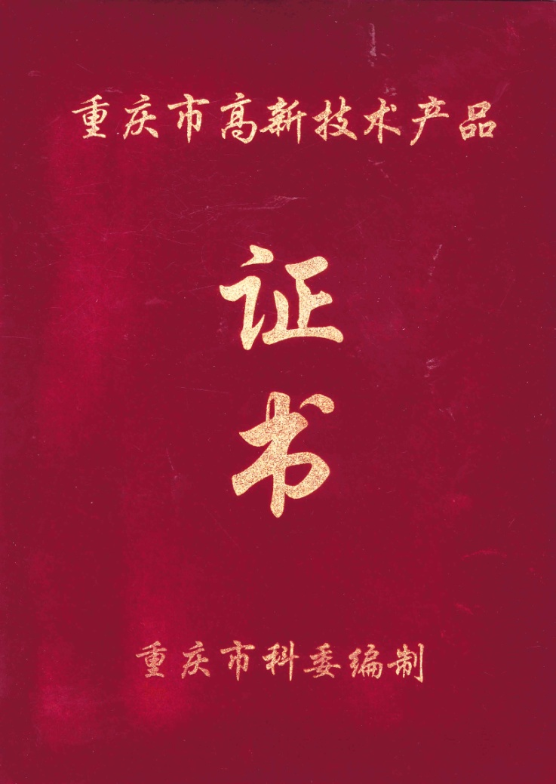
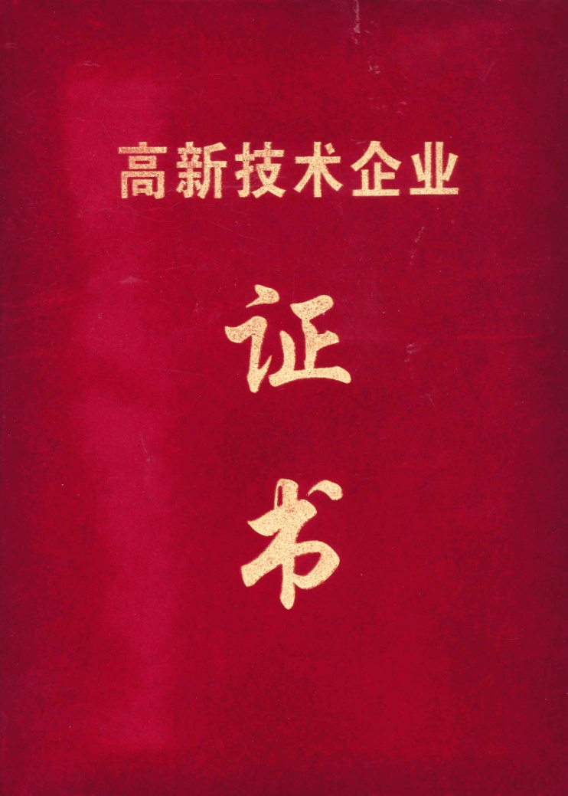
公司荣誉
Company Honour

Slide 13
PART 3
主要合作伙伴
Main Cooperative Partners

Slide 14
主要合作伙伴
Main Cooperative Partners
隆鑫通机
LONCIN Machine
润通通机
RATO Power Manufacturing
宗申通机
ZONGSHEN Power Machinery
美国G公司
Generac Corporation of America
美国CPI公司
CPI Corporation of America
美国冠军公司
Champion Corporation of America
美国CAT公司
American CAT Company
德国A公司
German A Company
德国V公司
German V Company
EMAK公司
EMAK Company
GGP公司
GGP Company
日本KGN公司
KGN Corporation of Japan

Slide 15
PART 4
组织机构Organization

Slide 16
组织机构
Organization
总经理
General manager
副总经理
Vice general manager
副总经理
Vice general manager
公司办 Office
综合财务部Finance department
销售部
Sales department
生产部
Production department
技术开发部 Technology department
质量工程部
Quality department
压铸车间
Die-casting workshop
机电技安室
ME safety office
检验组Inspection team
计划统计采购室Integrated purchasing office
机加车间
Machining shop
库管组
Warehouse Team
装配车间
Assembly workshop
后勤现场、机电修Logistics site, ME repair

Slide 17
PART 5
开发能力展示
Demonstration
of Development Capability

Slide 18

技术开发部
Technology Development Department
公司拥有一批从事化油器技术开发经验丰富、能力突出的人才队伍， 系统的开发流程，完善的开发制造、检测能力，能够更快更好的完成客户的新产品开发任务。
The company has a talent team with rich experience and outstanding ability engaging in carburetor technology development, system development process, perfect development, manufacturing and testing capabilities, can complete the customer's new product development tasks faster and better.

Slide 19
开发队伍
Development team：
公司拥有一批从事化油器技术开发经验丰富的人才队伍，有着很强的开发设计能力，可根据客户的需求，设计完成化油器的三维模型，并与主机厂共同协商和确认，按客户要求的进度，制作完成化油器样品，通过技术参数的测试和调整，达到主机厂和客户的要求。
The company has a talent team with rich experience engaged in carburetor technology development, which has strong development and design capabilities, and can design and complete the three-dimensional model of carburetor according to customer needs, produce and complete carburetor samplesand by consulting and confirming with the host plant and according to the rate of progress required by customer, and meet the requirements of the host plant and customers,through the testing and adjustment of technical parameters.

Slide 20
►
总工程师（高级工程师）1 人：从事化油器技术工作30年，有在日本三国合资企业和日本京滨技术合作企业的技术工作经验。
Chief Engineer (Senior Engineer), 1 person: engaged in the technical work of carburetor for 30 years , with technical experience wroking in Mikuni joint venter enterprise of Japan and Keihin technical cooperation enterprise of Japan.
►
技术部长（高级工程师） 1人：从事化油器技术工作26年，有在日本京滨技术合作企业的技术工作经验。
Head of technology department (Senior Engineer), 1 person：engaged in the technical work of carburetor for 26 years , and with the technical experience work in Keihin technical cooperation enterprise of Japan.
►
开发工程师8人：具有很强的工作能力，能按主机厂和客户的要求，完成化油器的设计和匹配工作。
Development Engineers, 8 persons: with strong working ability, able to complete the design and matching of carburetor according to the requirements of host plant and customers。

Slide 21

公司办 Office
产品开发流程 Product Development Process
主机厂产品需求(销售部、技术部)
Product Requirements of Host plant(Sales Department, Technology Department)
销售部组织立项评审
Sales Department organizes project-establishment evaluation
产品性能指标、特性、安全性
Requirements of product performance index, characteristics, safety
开发立项(销售部、技术部)
Development project establishment (Sales Department, Technology Department)
产品原理、外观、包装等要求
product principle, appearance, packaging, etc.
设计输入
Design input
产品图样
Product pattern
设计更改
Change in design
同类设计的样机和参考图纸资料
Prototype and Reference Paper for Similar Design
明细表
Specifications
设计输出(技术部)
Design Output (Technical Department)
不合格
NO
设计评审
Design review
工艺文件
Process documents
模具、工装制作
Mould and tool making
采用的国家、国际标准和法规
National, international standards and regulations adopted
包装说明
Packing instructions
试验、匹配
Testing and Matching
样件制作
Sample making
样件评审
Sample review
技术标准
Technical standard
小批量试产
Small batch trial production
小批评审
Small batch review
使用说明书
Instruction manual
产品合格证
Product Qualification Certificate
量产
Mass production

Slide 22
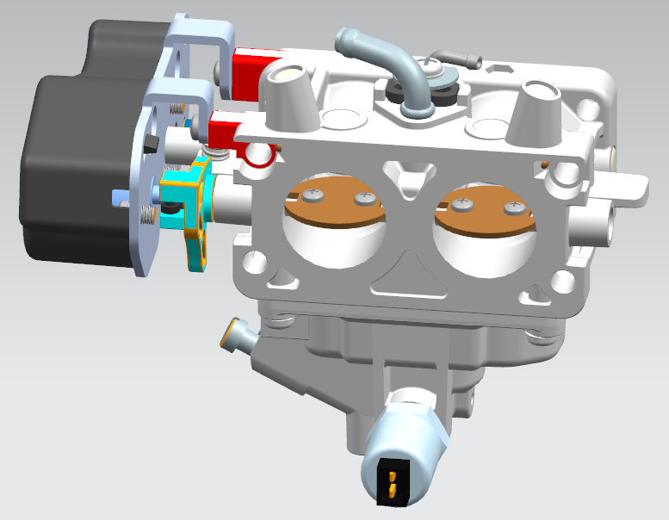
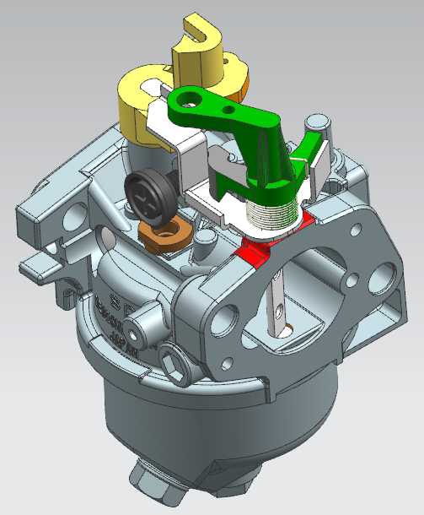
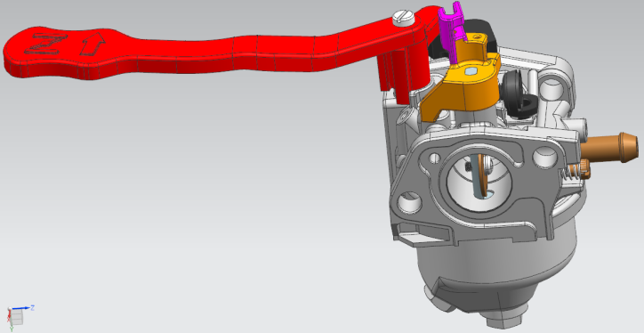
完善的开发制造、检测能力
Perfect Fevelopment, Manufacturing and Testing Capabilities
一、方案设计阶段
Schematic design phase
与主机厂共同设计开发新品，通过3D数据（UG、solidworks)来满足前期产品模拟设计要求。
Design and develop new products together with the host plant, and meet the requirements of product simulation design in the early stage through 3D data (UG, solidworks).

Slide 23
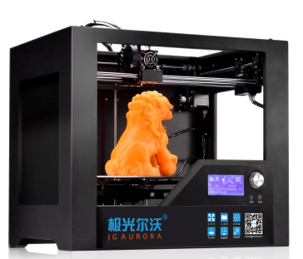
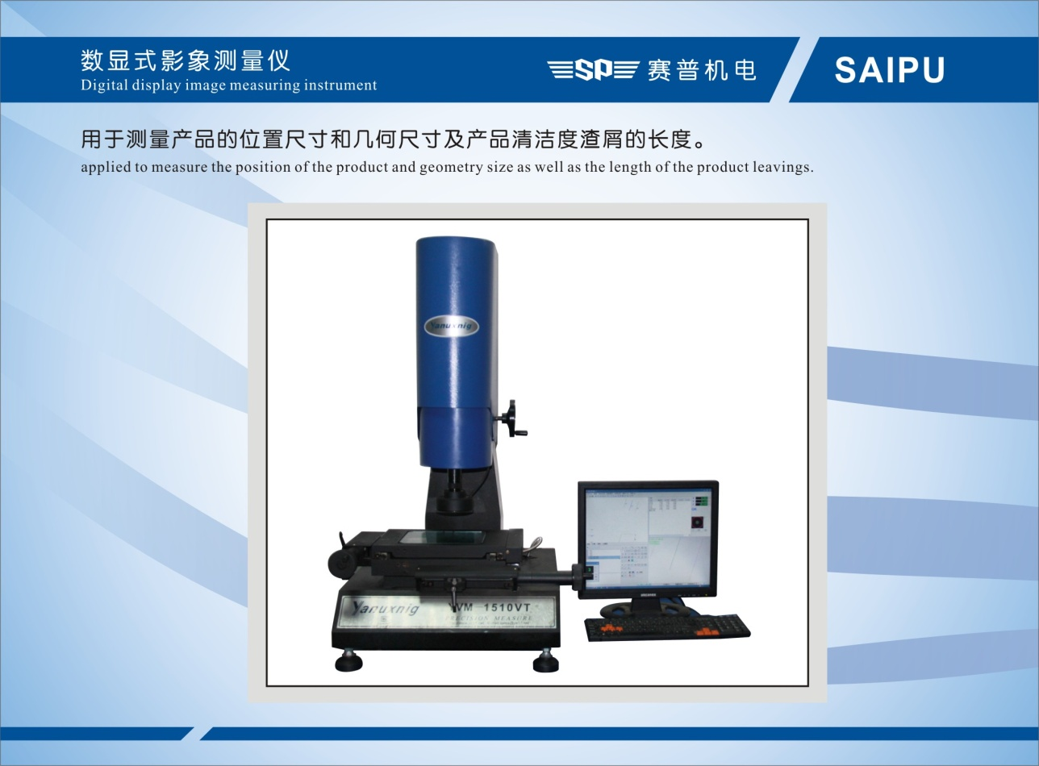
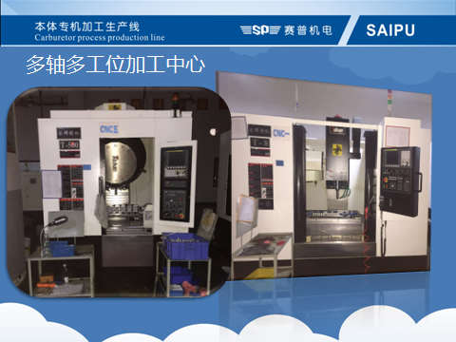
二、初样制作阶段 Preliminary sample producing stage
完善的开发制造、检测能力
Perfect ability of Development, Manufacture and Inspection
3D打印机
3D Printer
通过3D打印机能快速打印样件满足前期样机结构确认和试验。
The prototype can be printed quickly by 3D printer to meet the needs of confirmation and test of the structure of the preliminary e prototype.
投影仪能准确的检测零部件的尺寸。
Projector can accurately measure the size of parts.
数控加工中心能更好的满足各种产品加工需求。
CNC Machining Center can meet the processing needs of various products better.
高精密投影仪
High Precision Projector
Multi-axis multi-station machining center

Slide 24
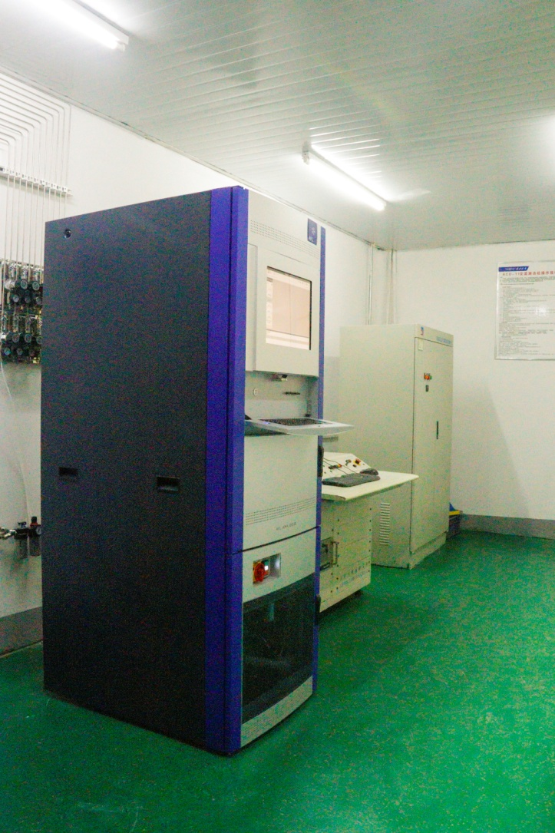
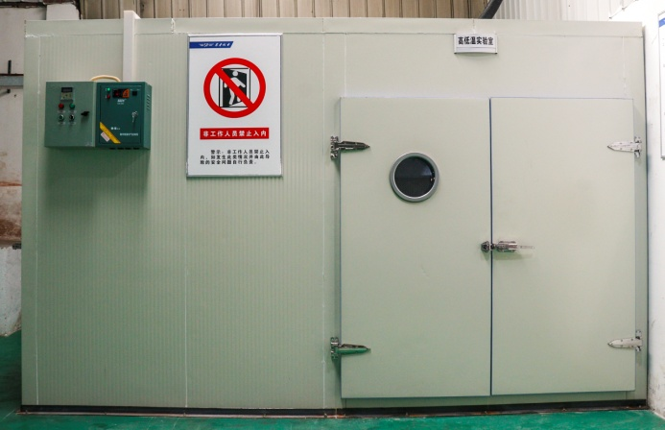
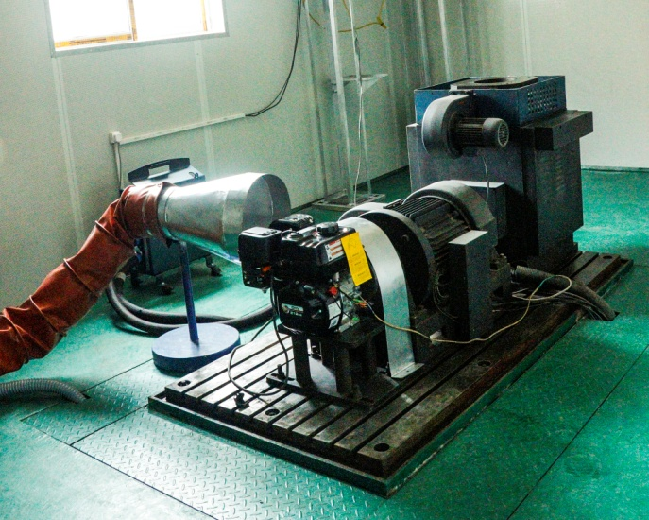
完善的开发制造、检测能力
Perfect Fevelopment, Manufacturing and Testing Capabilities
三、开发实验测试
Development Experiment and Test
通过发动机测功测试 、AVL工况排放测试、高低温启动试验 、终端测试等各个阶段来满足发动机化油器的匹配。
Through test of each stage, such as the engine dynamometer test, AVL emission test, high and low temperature start-up test, terminal test and so on, to meet the matching of engine carburetor.

Slide 25
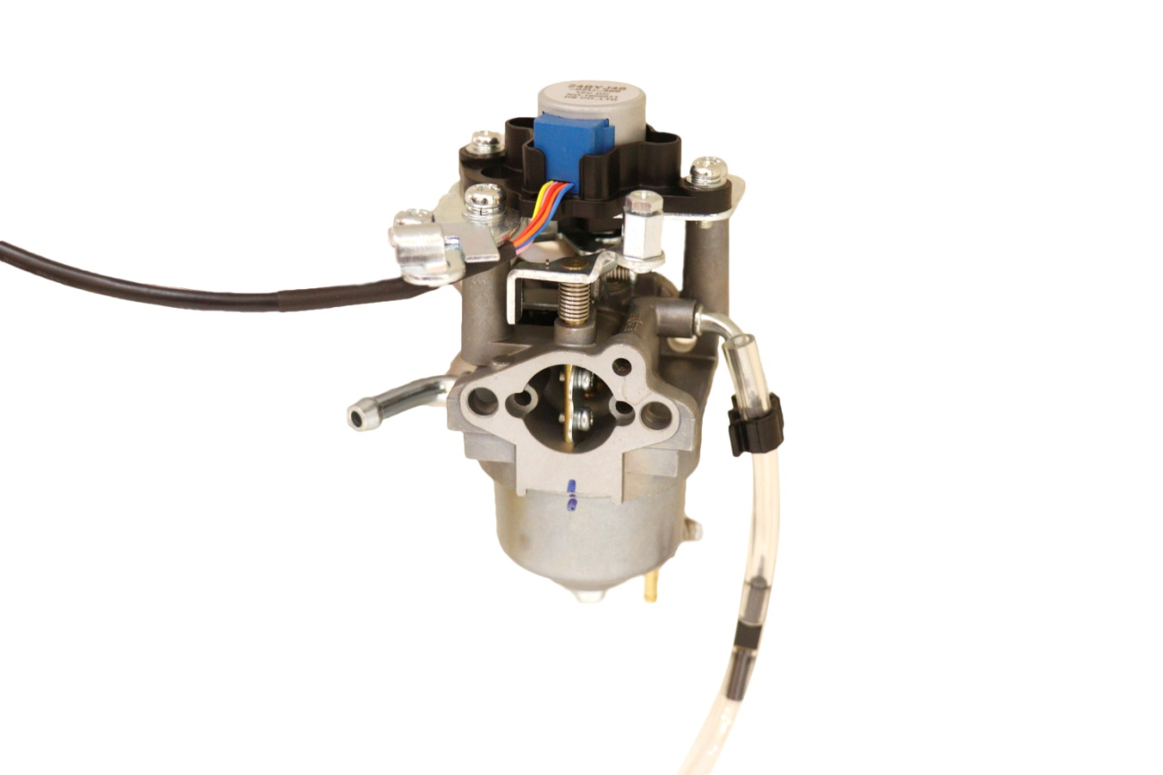
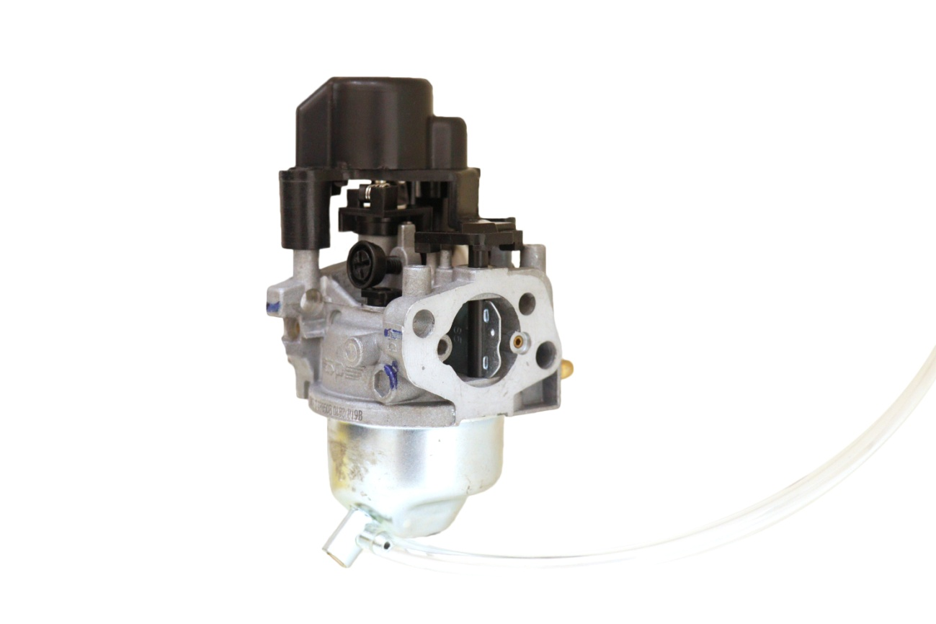
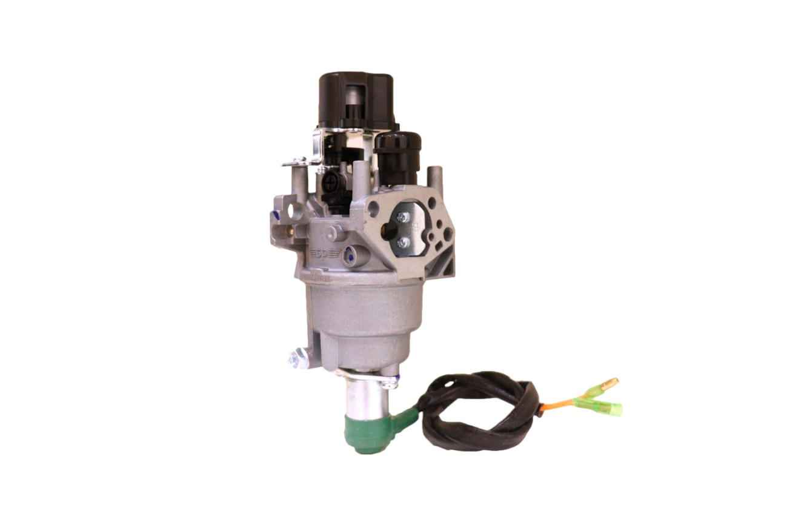
开发的部分新品
Some New Products Developed
2000i化油器
2000i Carburetor
3000i化油器
3000i Carburetor
7000i化油器
7000i Carburetor

Slide 26
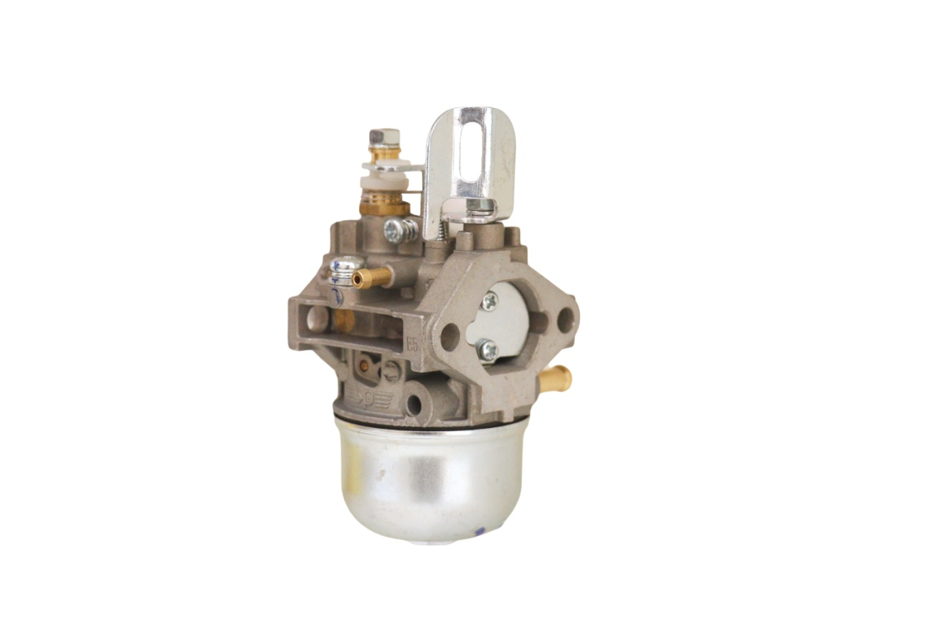
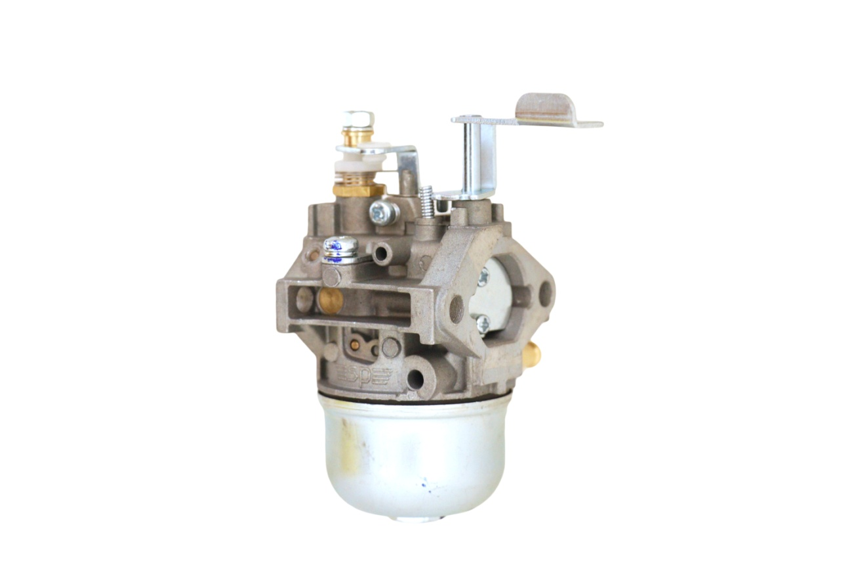
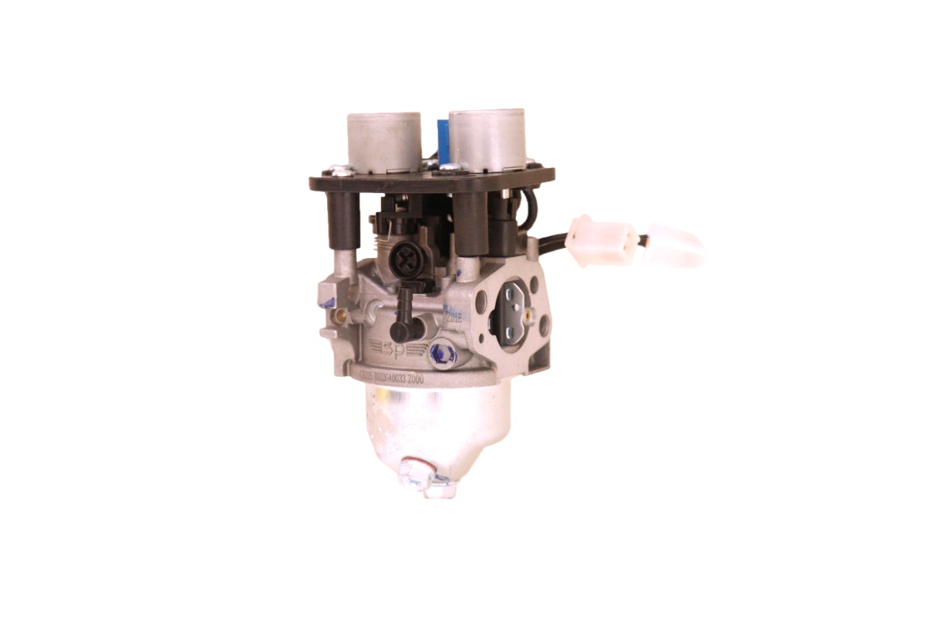
开发的部分新品
Some New Products Developed
夯机化油器
Rammer carburetor
夯机化油器（手动风门）
Rammer carburetor（ Manual throttle ）
增程器化油器
Extender carburetor

Slide 27
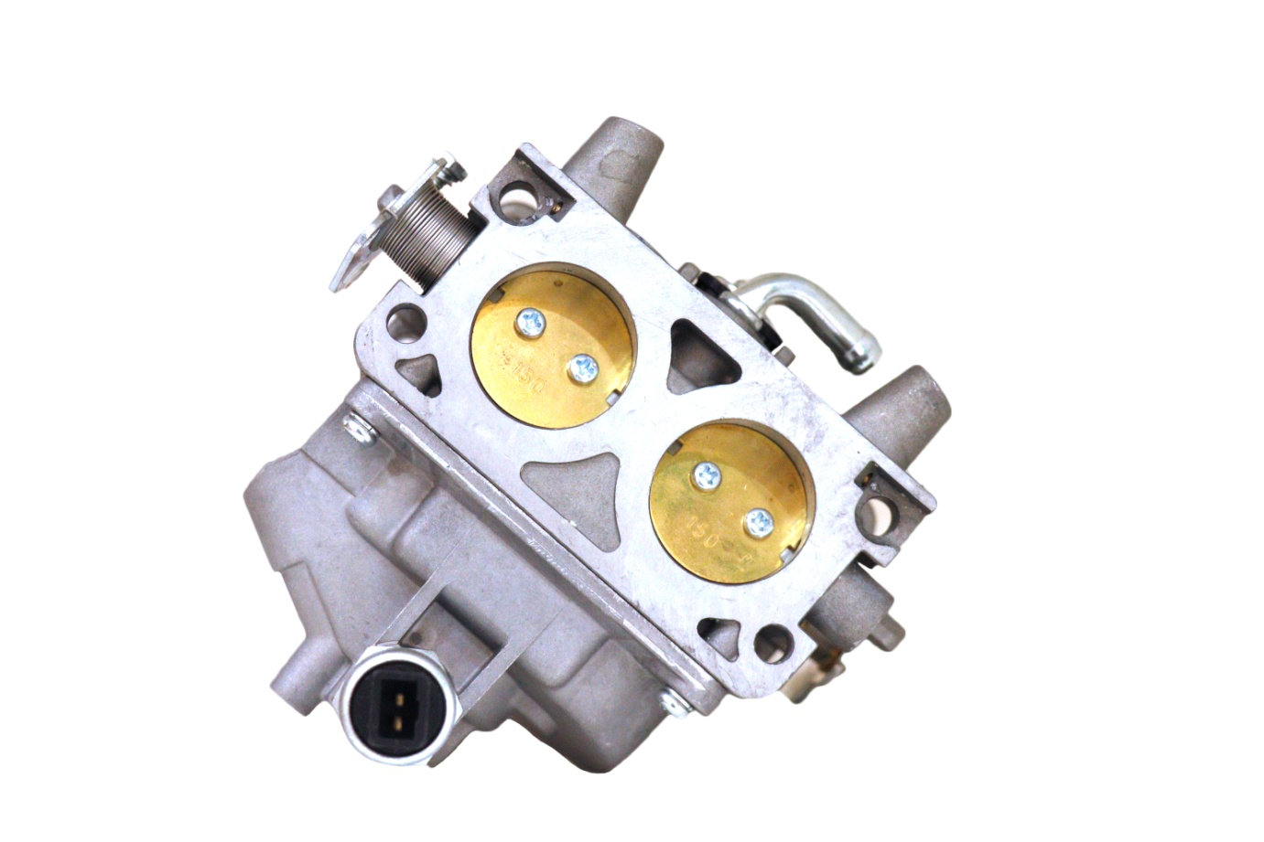
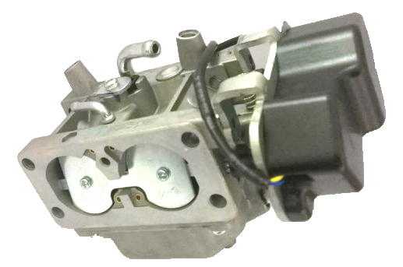
开发的部分新品
Some New Products Developed
双腔化油器
Double-barrel carburetor
双腔双控制2V78 化油器
Carburetor of double barrel double control 2V78

Slide 28
PART 6
品保能力展示
Demonstration of the Quality Assurance Ability

Slide 29
质量工程部
Quality engineering department
公司拥有一支敬业的质量管理队伍，负责公司的质量体系有效运行，对化油器产品从原材料、零部件入厂检验、生产加工和装配、到成品出厂检验的全过程实行过程控制，使产品制造全过程处于受控状态，确保产品的一致性。
The company has a dedicated quality management team which is responsible for the effective operation of the company's quality system, and Implement process control in the whole process of carburetor products from the factory incoming inspection of raw materials and spare parts, production, processing and assembling, till the factory-leaving inspection of the finished products, to ensure the whole process of product manufacturing is in a controlled state, so as to ensure the consistency of the products.

Slide 30
质量管理队伍
Quality control team
总工程师1人：从事化油器技术工作30年，有在日本三国合资企业和日本京滨技术合作企业的技术工作经验。
Chief Engineer , 1 person: engaged in the technical work of carburetor for 30 years ,
with technical experience working in Mikuni joint venter enterprise of Japan and Keihin technical cooperation enterprise of Japan.
质量部长1人：从事化油器工作10年，有着丰富的质量管理工作经验。
Head of quality, 1 person: engaged in the technical work of carburetor for 10 years, with rich working experience of quality control.
全质员2人 ，现场质量管理人员4人，产品检验人员14人。
There are There are 2 total quality management persons, 4 on-site quality control
personnel and 14 product inspectors.

Slide 31
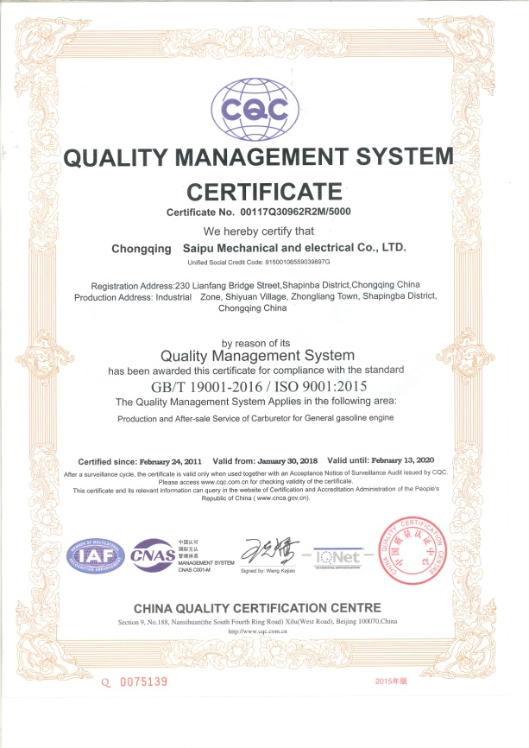
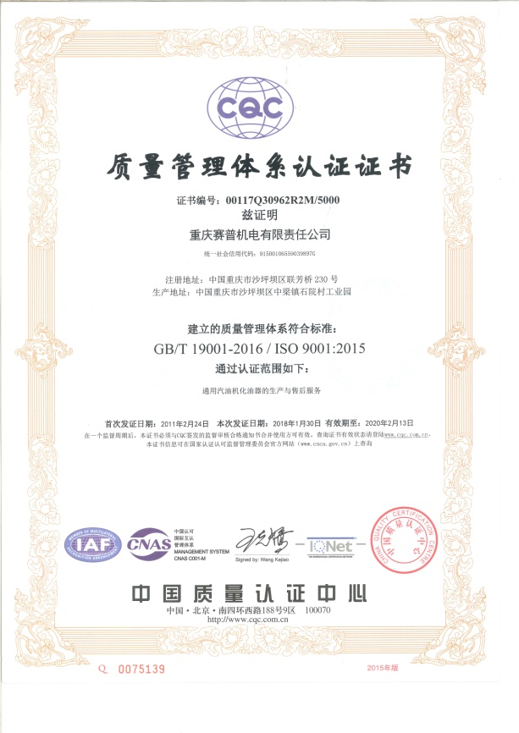
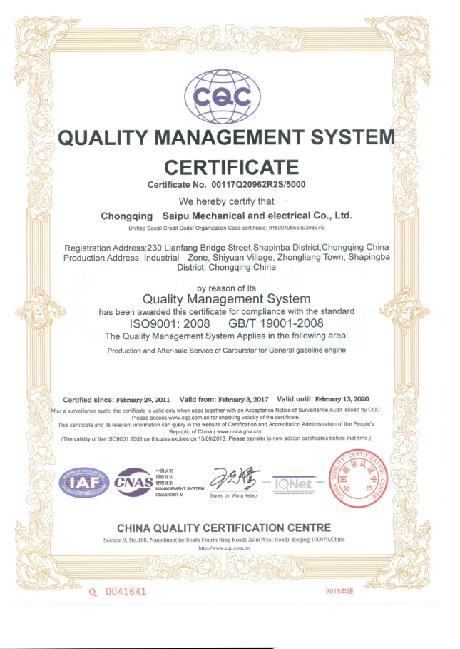
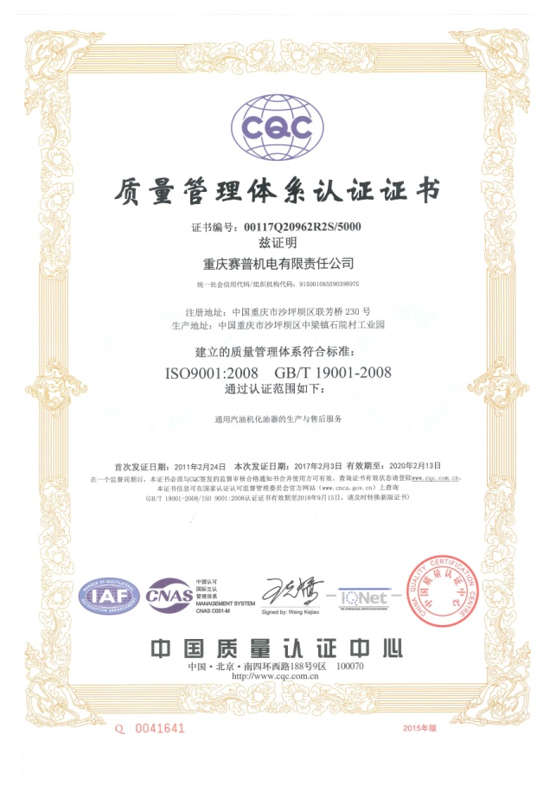
品保能力-体系认证证书
Quality Assurance Ability- System certificate

Slide 32
清洁度控制流程
Cleanliness Control Process

Slide 33
一、自制零部件控制
Cleanness Control of Self-made Parts and Components
分类
Classification
二、机加生产控制
Machining Production Control
三、装配生产控制
Assembly production control

Slide 34
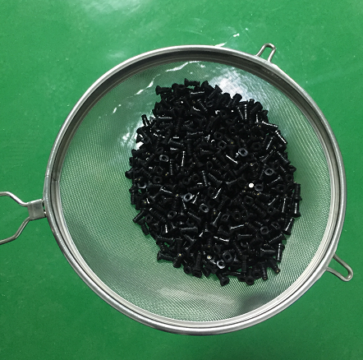
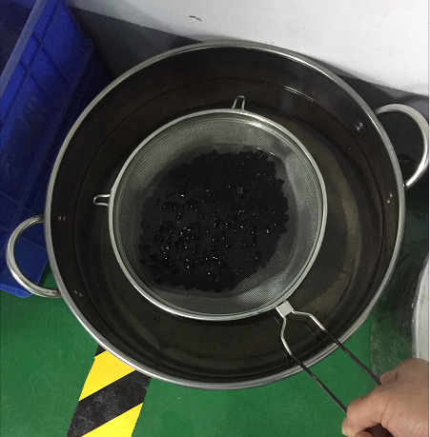
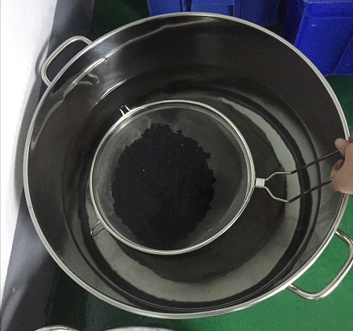
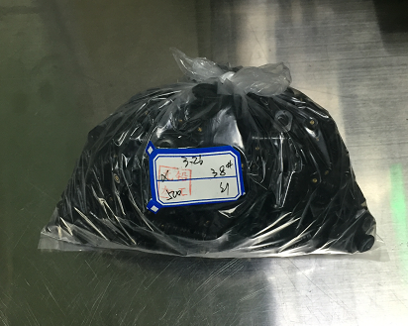
一、自制零部件清洁度控制
Cleanness Control of Self-made Parts and Components
加工完成后对零部件进行清洗 。
Clean the parts and components after processing
将合格零部件放入盛具内，使用洗涤汽油进行二次清洗，吹净封袋入库。
Put the qualified parts and components into the container, wash with washing gasoline for second cleaning, then blow clean and seal into bag and put into storage.
清洗盛具
washing container
清洗一
washing 1
清洗二
washing 2
封袋入库
seal in bag and put in storage

Slide 35
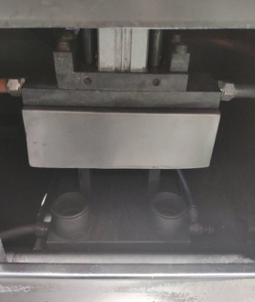
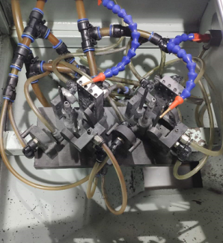
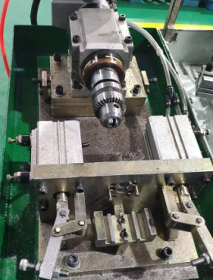
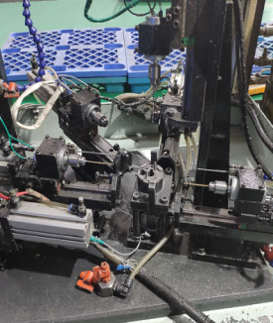
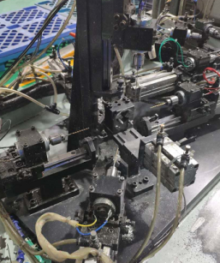
二、机加生产清洁度控制
Cleanness Control of Machining Production
去除本体机加毛刺、飞皮(工序一)
Removal of burrs and flying skins from body machining process (Procedure 1)
去除本体毛刺、飞皮(工序二)
Removal of body burrs and flying skins (Procedure 2)
去除本体毛刺、飞皮(工序三)
Removal of body burr and flying skin (process 3)
本体机加完成
Completion of body machining
本体清洗
Body cleaning
本体气吹
Body blowing
*本体清洁度检查
*过滤器每天清洗
*要求2500件换水
Body cleanliness inspection
* Clean filters every day
* Require water change
Of 2500 pieces
夹具定期进行清洗
Fixtures are cleaned regularly
◎通过对本体各孔道去毛刺、清洗、气吹，保证本体各孔道清洁度。
Through deburring, cleaning and air blowing on each hole of the body, ensure the cleanliness of each hole of the body.

Slide 36
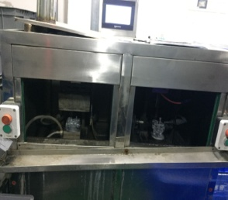
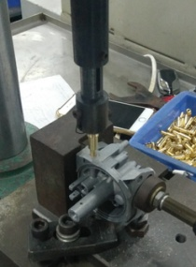
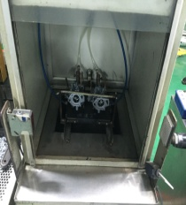
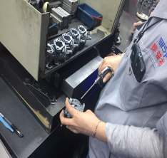
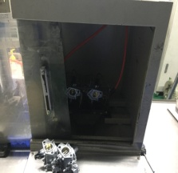
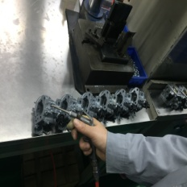
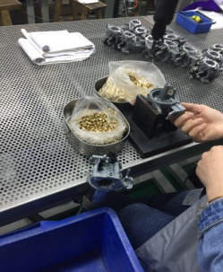
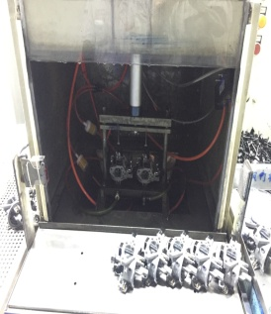
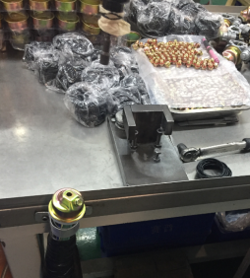
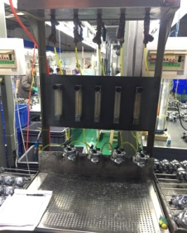
三、装配生产清洁度控制
Cleanness Control of Assembly Production
清洁度抽查 Cleanness random check
清洁度抽查Cleanness random check
清洁度抽查Cleanness random check
铜件组合压入、进油管 Copper assemblies are pressed into the intake pipe
节气门装配、过渡孔加工
Throttle valve assembly, transition hole processing
气吹怠速量孔孔道
Air blowing idle speed
Hole of main jet
主油井吸尘 Dust absorption of the main oil well
浮子室盖装配
Float chamber cover assembly
本体上线清洗On-line cleaning of the body
气吹
air blow
气吹
air blow
化油器进油系清洗
吊油
Oil lifting
夹具定期清洗，定期更换水及过滤器 Fixtures are cleaned regularly and water and filters are replaced regularly.
产品采用下拉式压入，进油接管导向部分与本体直接接触，压入时不会切屑 Products are pressed in by pulling down, and the guide part of the oil intake nozzle contacts the body directly, so that cutting will not happen when pressing.
气吹过渡孔
Air blow transition hole
主油井拧紧后使用吸尘器进行吸尘 Vacuum clean oil well after tightening it
夹具定期清洗、过滤器定期更换
Fixtures are cleaned regularly and filters are replaced regularly
浮子室盖装配前使用吸尘器进行吸尘Vacuum clean float chamber cover before assembly
采用PVC透明胶管，目视无损坏，同时定期更换过滤器Using PVC transparent rubber tube, no visible damage, and filters should be replaced regularly
通过对本体主油系、怠速系，清洗、气吹，保证清洁度符合要求（杂质总重量≤4mg，杂质直径、长度＜0.4mm）。解决因杂质造成的化油器漏油、游车问题。
Clean and blow the main oil system and idle system of the body to ensure that the cleanliness meets the requirements (total weight of impurities ≤4mg, diameter and length of impurities < 0.4mm). Solve carburetor oil leakage and unstable running problems caused by impurities.

Slide 37
一致性控制流程
Consistency Control Flow

Slide 38
阶段描述（成熟工艺-品质基石）
Stage Description (Mature Process-Quality Cornerstone)
本体压铸
零件控制
成品装配
★成品装配
•过渡孔加工：采用专用加工设备，保证过渡孔和节气门片位置的一致性。
•怠速100%的调试，过渡点100%检测，确保化油器低速性能的一致性。
•全开点100%的检测，确保化油器主油系性能的一致性。
★本体加工
•采用高精度组合钻床加工
•采用高精度气动检测仪、光学投影仪，检测设备
•采用全自动机械手臂压铸机
•化油器针阀密封性检查：100%地对化油器针阀系进行密封性检测，确保化油器针阀系的密封性。
•化油器总成密封检查：100%地对化油器总成进行密油测试，保证化油器总成无漏油现象发生。
•综合流量试验台：采用日本三菱技术的综合流量试验台，可同时监控化油器的负压、空气流量、燃油流量，精确地测试化油器的空燃比。
•完善的模具管理制度保证物料有序管理。
•压铸参数固化
★关重件自制
•采用高精度自动加工、自动检测
★常规件检测
•采用完善的检测设备保证零部件各方面满足技术要求。

Slide 39
采用全自动机械手臂压铸机 。
Using die-casting machine with
Fully automatic mechanical arm.
完善的模具管理制度保证物料有序管理。
压铸参数固化。
Perfect mould management system ensures orderly material management.
Solidification of die-casting parameter.
本体压铸
Die-casting of the body

Slide 40
本体加工
采用高精度组合钻床加工。
采用高精度气动检测仪、光学投影仪，检测设备。
Main body processing
Using high precision combined drilling machine.
Using High-precision pneumatic detector, optical projector, testing equipment.
关重件自制
采用高精度自动加工、自动检测。
Self-Making of key parts
Adopt high precision automatic processing and automatic detection.
常规件检测
采用完善的检测设备保证零部件各方面满足技术要求。
Detection of conventional parts
Adopt perfect testing equipment to ensure that all aspects of components meet technical requirements.
零件控制
Part control

Slide 41
★成品装配
★Assembly of finished products
过渡孔加工：采用专用加工设备，保证过渡孔和节气门片位置的一致性。
Transition hole processing: special processing equipment is used to ensure the consistency of the position of transition hole and throttle plate.
怠速100%的调试，过渡点100%检测，确保化油器低速性能的一致性。
The idle speed is 100% debugged and the transition point is 100% tested to ensure the consistency of the carburetor's low speed performance.
全开点100%的检测，确保化油器主油系性能的一致性。
Full open points are 100% tested to ensure the consistency of the performance .of carburetor’s main oil system.
化油器针阀密封性检查：100%地对化油器针阀系进行密封性检测，确保化油器针阀系的密封性。
Check the sealing of carburetor needle valve: 100% sealing test of carburetor needle valve system to ensure the sealing of carburetor needle valve system.
化油器总成密封检查：100%地对化油器总成进行密油测试，保证化油器总成无漏油现象发生。
Carburetor assembly seal inspection: 100% sealing oil test for carburetor assembly to ensure that no leakage of carburetor assembly.
综合流量试验台：采用日本三菱技术的综合流量试验台，可同时监控化油器的负压、空气流量、燃油流量，精确地测试化油器的空燃比。
Comprehensive flow test bench: The comprehensive flow test bench using Japanese Mitsubishi technology , which can monitor the negative pressure, air flow and fuel flow of carburetor at the same time, and accurately test the air-fuel ratio of carburetor.
成品装配
Finished product assembly

Slide 42
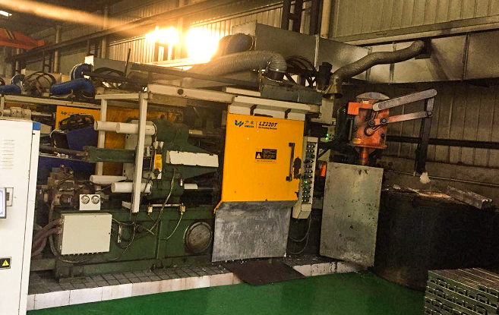
本体压铸
Die-casting of the Body
◎ 员工对首件、过程件（每小时/次）、末件进行自检，并作相关记录。
Employees conduct self-inspection on the first, in-process (per hour/time) and final pieces and make relevant records.
◎ 产线配备专职检验员，对首件、过程件（每小时/次）、末件全程跟踪巡查并记录。
The production line is equipped with full-time inspectors to track and record the whole process of the first, in-process (per hour/time) and final pieces.

Slide 43
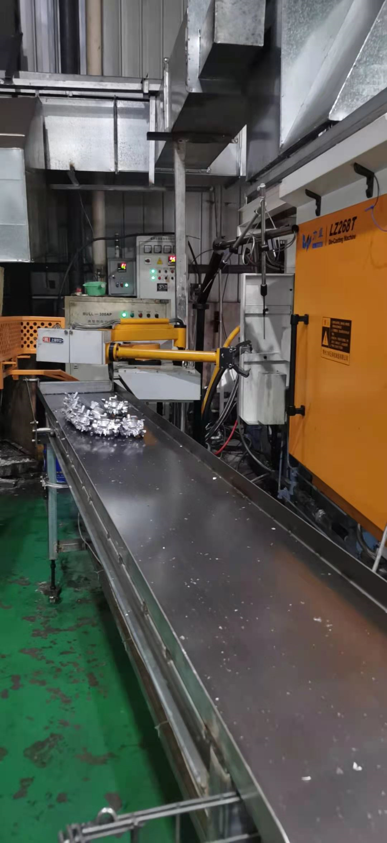
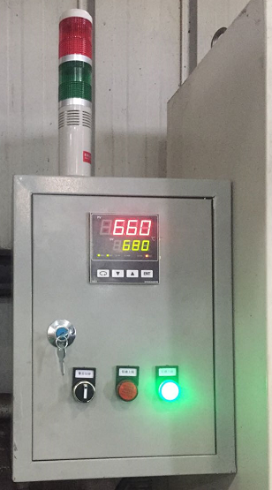
本体压铸
Die-casting of the Body
◎ 全部压铸机都采用国内领先的生产技术，配备全自动化机械手臂、全自动传输，有效保证压铸产品的精密要求。
All die-casting machines adopt domestic leading production technology and are equipped with fully automated mechanical arm to ensure the precision requirements of die-casting products.
◎ 熔炉采用全自动温度控制，保证材料熔炼成分一致。
The furnace adopts automatic temperature control to ensure the same melting composition of materials.

Slide 44
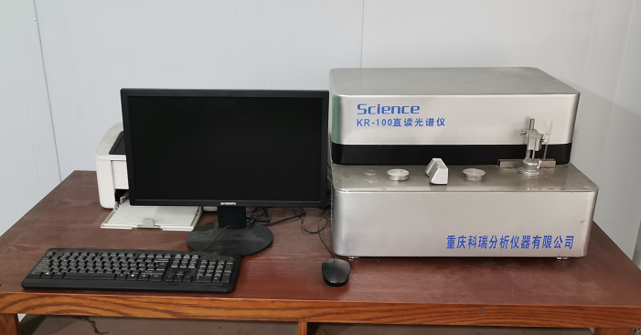
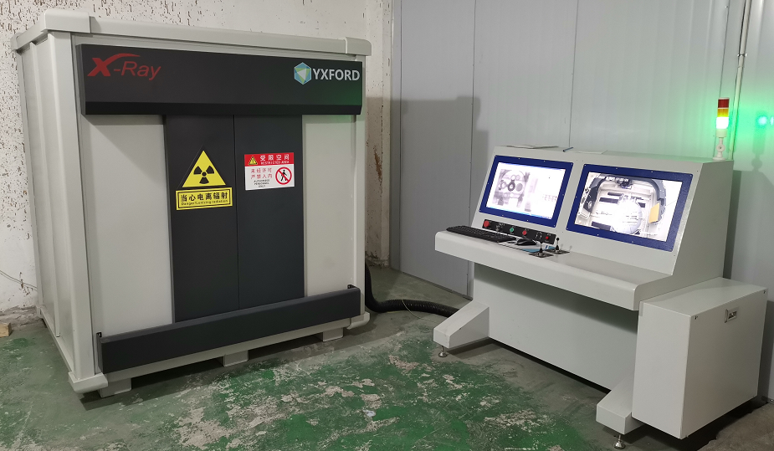
本体压铸
Die-casting of the Body
◎ 原材料入厂后分批次管理，每批原材料都附带质量证明书，入厂光谱仪成分分析，确保原材料合格入库。产品通过欧盟ROHS和REACH认证。
After raw materials enter the factory, we are managed in batches. Each batch of raw materials is attached with quality certificate to ensure that the quality of raw materials is qualified. Products through the EU ROHS and REACH certification.
◎ 产品首件、生产过程 ，采用探伤仪检测内部组织，确保产品内部结构致密。
The first part of the product, the production process, the use of flaw detector to detect the internal tissue, to ensure that the internal structure of the product compact.

Slide 45
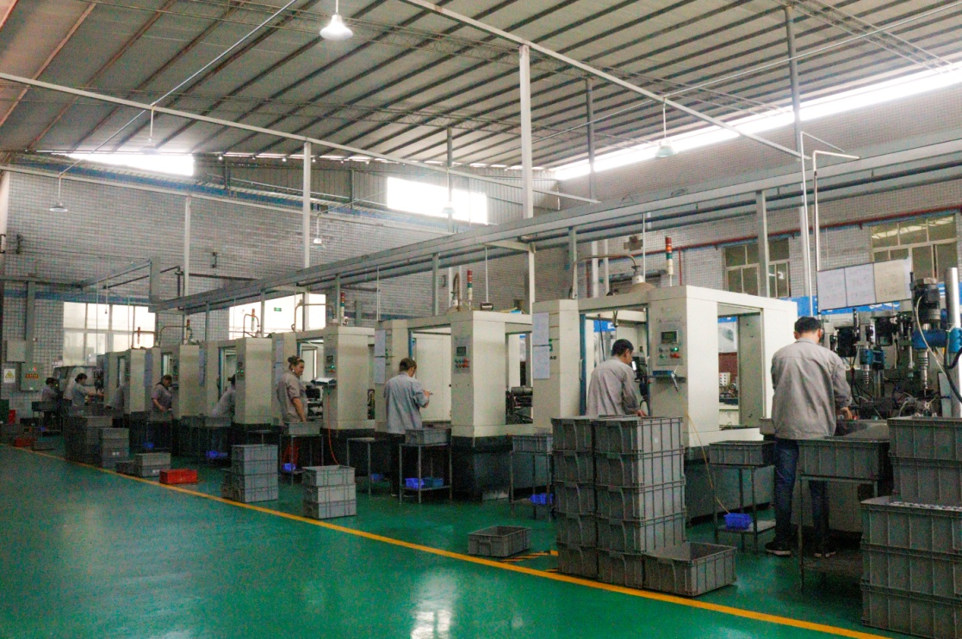
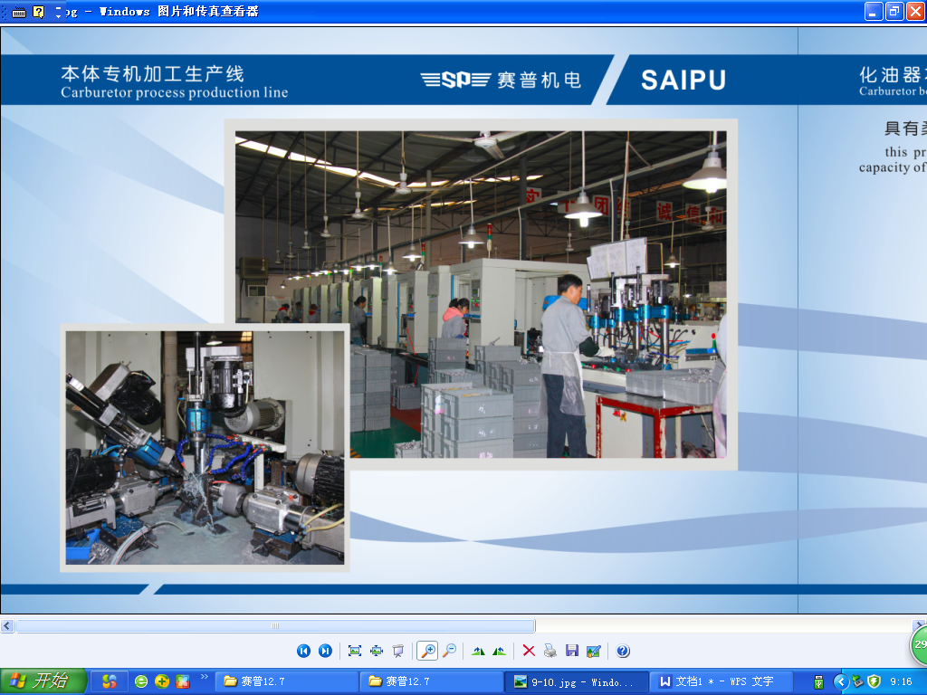
本体加工
Body processing
◎ 采用高精度组合钻床加工保证加工精度及一致性。
High precision combined drilling machine is used to ensure machining accuracy and consistency.
员工对首件、过程件（每小时/次）、末件进行自检，并作相关记录。
Employees conduct self-inspection on the first, in-process
(per hour/time) and final pieces and make relevant records.
产线配备专职检验员，对首件、过程件（每小时/次）、末件全程跟踪巡查并记录。
The production line is equipped with full-time inspectors to track and record the whole process of the first, in-process (per hour/time) and final pieces.

Slide 46
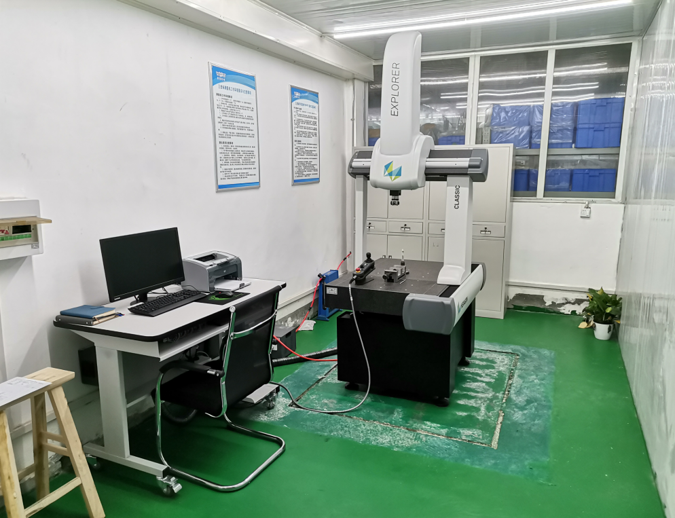
本体检测
Body Test
◎采用高精度三坐标检测仪、光学投影仪，保证加工尺寸精度。
◎High precision pneumatic
tester and optical projector are used to ensure the accuracy of machining dimension.
三坐标检测仪
Three-coordinate detector
光学投影仪
Optical projector

Slide 47



关重零部件加工检测
Processing and Test of Key Parts
量孔加工
Processing of main jet
量孔检测
Test of main jet
量孔标识刻印
Marking for main jet identification
◎ 采用高精度自动加工、检测设备，保证部件流量精度及一致性。
员工对首件、过程件（每小时/次）、末件进行自检，并作相关记录。
产线配备专职检验员，对首件、过程件（每小时/次）、末件全程跟踪巡查并记录。
◎ High precision automatic processing and testing equipment is used to ensure the flow accuracy and consistency of components.
Employees conduct self-inspection on the first, in-process (per hour/time) and final pieces and make relevant records.
The production line is equipped with full-time inspectors to track and record the whole process of the first, in-process (per hour/time) and final pieces.

Slide 48





部件监控设备
Component monitoring equipment
浮子泄漏全检 Fullnspection of Float Leakage
硬度测试仪Hardness-testing device
盐雾检测Salt-spray chck
油面检测
Oil surface check
过渡孔检测 Transition hole check
◎ 采用系列专用仪器保证部件符合技术要求。
◎ A range of special instruments are used to ensure that the components meet the technical requirements.

Slide 49



化油器装配
Carburetor Assembly
◎ 过渡孔加工：先装节气门，检查泄漏后，再加工过渡孔，保证过渡孔和节气门片位置的一致性。
◎ 在线上对化油器怠速100%的调试，过渡点100%检测，确保化油器低速性能的一致性。
◎ 在线上对化油器全开点100%的检测，确保化油器主油系性能的一致性。
◎ Transition hole processing: First install throttle, then process transition hole, after checking leakage,
to ensure the consistency of the position of the transition hole and that of the throttle piece.
◎ Debug on line 100% of the carburetor idle speed and test 100% of the transition point to ensure
the consistency of the carburetor low speed performance.
◎ Inspect on-line 100% of the carburetor open point to ensure the consistency of the performance
of the carburetor main oil system .

Slide 50


化油器装配
Carburetor assembly
◎ 化油器针阀密封性检查：通过0.03MPa的压力100%地对化油器针阀系进行密封性检测，确保化油器针阀系的密封性。
◎ 化油器总成密封检查：100%地对化油器总成进行密油测试，保证化油器总成无漏油现象发生。
Carburetor needle valve sealing inspection: Test 100% of the carburetor needle valve system by pressure of 0.03MPa to ensure the tightness of carburetor needle valve system.
Leakage check of carburetor assembly: Test 100% of the carburetor assembly for sealing oil tightness to ensure that no oil leakage occurs in the carburetor assembly.

Slide 51

化油器装配
Carburetor Assembly
◎ 综合流量试验台：采用日本三菱技术的综合流量试验台，可同时监控化油器的负压、空气流量、燃油流量，精确地测试化油器的空燃比，更精确地反映化油器的制造精度，优于同行业使用的新科公司7604设备（不能监控空气流量，不能测试空燃比）。
◎ Comprehensive flow test bench: The comprehensive flow test bench using Japanese Mitsubishi technology , can monitor the negative pressure, air flow and fuel flow of carburetor at the same time, accurately test the air-fuel ratio of carburetor，and more accurately reflect the manufacturing accuracy of carburetor, and is superior to that of the 7604 numbers of equipment ( which can not monitor air flow and can not test air-fuel ratio) of Xinke Company used in the same industry.
员工对首件、过程件（每小时/次）、末件进行自检，并作相关记录。
Employees conduct self-inspection on the first, in-process
(per hour/time) and final pieces and make relevant records.
产线配备专职检验员，对首件、过程件（每小时/次）、末件全程跟踪巡查并记录。
The production line is equipped with full-time inspectors to track and record the whole process of the first, in-process (per hour/time) and final pieces.

Slide 52


PART 7
生产组织能力展示
Demonstration of Production
Organizational Capacity

Slide 53
生产组织能力
Organizational Capacity of Production
成品装配线6条，机加线4条，本体压铸机10台，从本体压铸、机加、关重零件加工到成品装配完成，设备产能在600万套以上。生产线设备性能运行稳定、可靠，本体压铸和部份量孔加工、检测实现了全自动化生产，配套体系稳定可靠，保证了产品品质的一致性。
There are 6 assembly lines, 4 machining lines and 10 body die-casting machines, from the body die-casting , machining, key parts processing to the completion of finished product assembly, the production capacity of the equipment is more than 6 million sets. The stable and reliable operation of production line equipment performance, the realization of automatic production of the body die-casting and processing and testing of partial jets, and the stability and reliability of the supporting system ensure the consistency of product quality.

Slide 54


本体压铸生产线
Body Die-Casting Production Line

Slide 55






本体机加生产线
Body Machining Production Line

Slide 56






零件加工区
Parts Processing Area

Slide 57










成品装配线
Finished Products Assembly Line

Slide 58

环保处理系统
Environmental Treatment System

Slide 59
PART 8
产品展示
Product Demonstration

Slide 60




变频机组化油器
Frequency Conversion Unit Carburetor
2000i化油器
2000i Carburetor
3000i化油器
3000i Carburetor
3500i化油器
3500i Carburetor
7000i化油器
7000i Carburetor

Slide 61



垂直轴化油器
Vertical Axis Carburetor
1P65自动风门
1P65 Automatic throttle
1P70系列
1P70 Series
1P90系列
1P90 Series

Slide 62



垂直轴化油器
Vertical Axis Carburetor
1P62系列
1P62 Series
1P65联动风门
1P65 Linkage throttle
1P65手动风门 1P65 Manual throttle

Slide 63



机组动力化油器
Unit Power Carburetor
1KW机组
1KW Unit
1KW隆鑫专用
1KW Appropriative LONCIN
3KW机组
3KW Unit

Slide 64



机组动力化油器
Unit Power Carburetor
5KW机组
5KW Unit
6KW自动风门机组
6KW Automatic throttle unit
7.5KW机组化油器带电磁阀
7.5KW Unit carburetor with solenoid valve

Slide 65



机组动力化油器
Unit Power Carburetor
7KW机组
7KW Unit
7KW机组化油器带电磁阀
7KW Unit carburetor
with solenoid valve
7KW机组化油器自动阻风门
7KW Unit carburetor with automatic choke valve

Slide 66

机组动力化油器
Unit Power Carburetor
12KW双腔化油器
12KW Double-barrel carburetor
燃气机组化油器系列
Gas generating unit carburetor series

Slide 67


水平轴动力化油器
Horizontal Axis Power Carburetor
152系列
152 Series
168扫雪机系列
168 Snow sweeper series

Slide 68



水平轴动力化油器
Horizontal Axis Power Carburetor
168系列1
168 Series 1
168系列2
168 Series 2
168系列3
168 Series 3

Slide 69



水平轴动力化油器
Horizontal Axis Power Carburetor
180系列
180 Series
190系列
190 Series
192系列
192 Series

Slide 70
PART 9
业绩展示-产销量
Performance Demonstration - Production and Sales Volume

Slide 71
业绩展示-产销量
Performance Demonstration - Production and Sales Volume
3741376
2876143
2763879
2448749
合计
Total
2081256
1684054
1500152
952838
单位：套/年
727045
314094
Units:set/year
2011
2012
2013
2014
2015
2016
2017
2018
2019
2020
总销量：19,089,586 （套）
Total sales volume:19,089,586(set)

Slide 72
Thank you!

